Slide 1
LLM analysis
Introduction, Principle & Models in market
Pengyao Zhao

Slide 2
Introduction
Deep Learning Model
Language Model
Large Language Model (LLM)

Slide 3
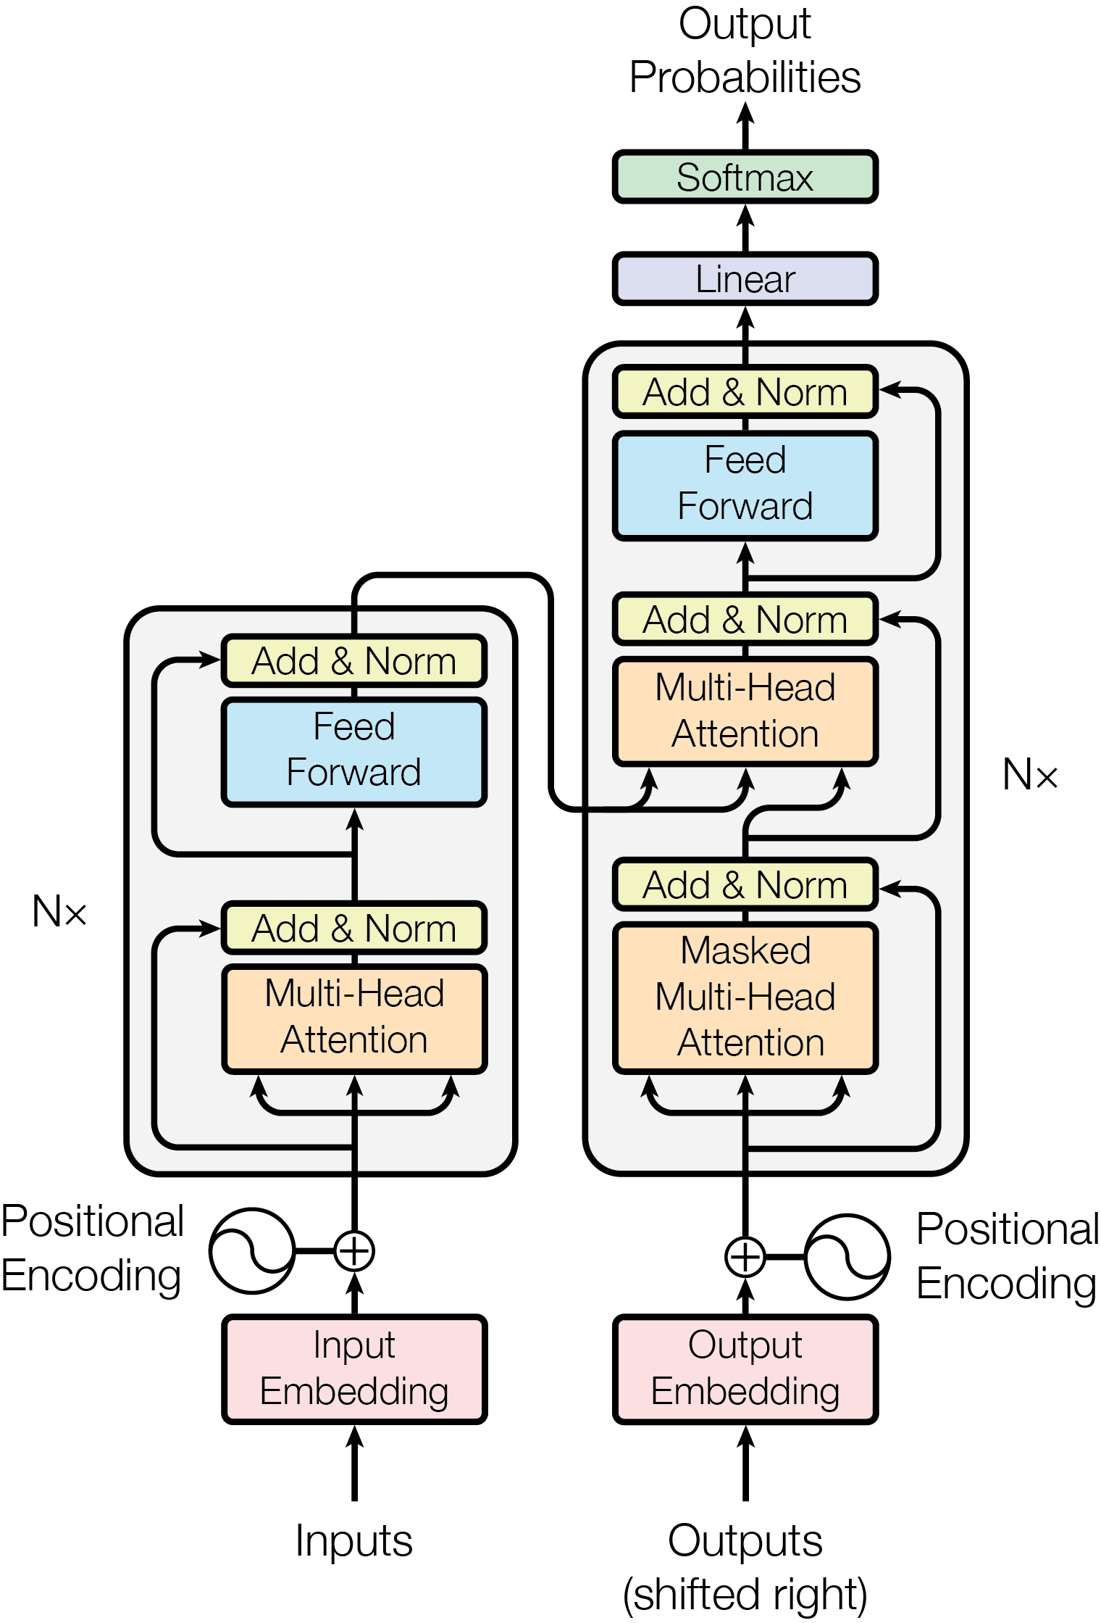
Deep Learning Model
A deep learning model is based on artificial neural networks with multiple layers between the input and output layers.
These models are capable of learning hierarchical representations of data through the process of training on large amounts of labeled data.

Slide 4
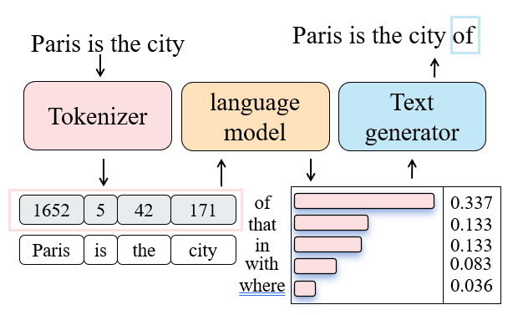
Language Model
A modern language model is a deep learning model that is trained to predict the probability of output words. There are three key components of the language model pipeline as following.
Architecture: Transformer architecture, which is used in nearly every modern LLM.
Tokenizer: Convert text data into a token format that the model can understand.
Text generator: Generate output sequences from probability of words. Common strategies include greedy decoding, beam search.

Slide 5
Large Language Model
large language model (LLM) : A language model that achieves the emergent abilities that are not present in small models but arise when the scale reaches a certain level.
The emergent abilities specifically refer to in-context learning (understand prompt), instruction following, and step-by-step reasoning (involve intermediate reasoning steps).
The scale specifically refers to the parameter count and the amount of text training data. An example in Table 1 shows the scale difference between LLM and small language model (SLM).
Table1 Scale difference between LLM and SLM
model | parameter count | amount of training data
BERT | 340M | 3300M words
Llama3 (large model) | 70B | 15T tokens
Note: 1 token ~= ¾ words

Slide 6
LLM’s Principles
Supervised Pre-training
Supervised Fine-Tuning (SFT)
Preference Alignment (optional)

Slide 7
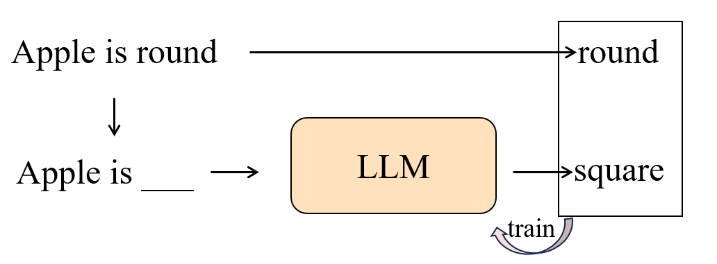
Supervised pretrain
Supervised pre-training is a very long and costly process, where models are only trained on a next-token prediction task.

Slide 8
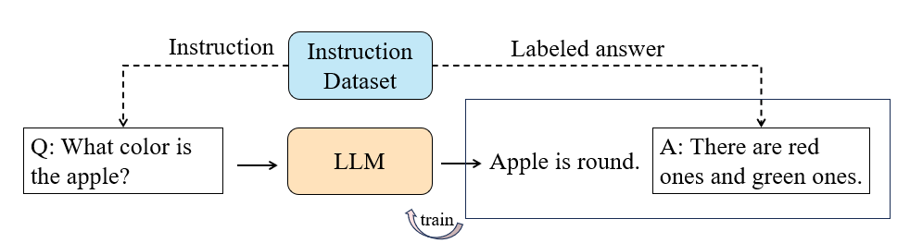
Supervised Fine-Tuning (SFT)
Only a pre-trained model is not helpful assistants, but Supervised Fine-Tuning (SFT) can enhance its ability to respond to instructions.
SFT achieves this by using datasets that contain instruction-answer pairs for training.

Slide 9
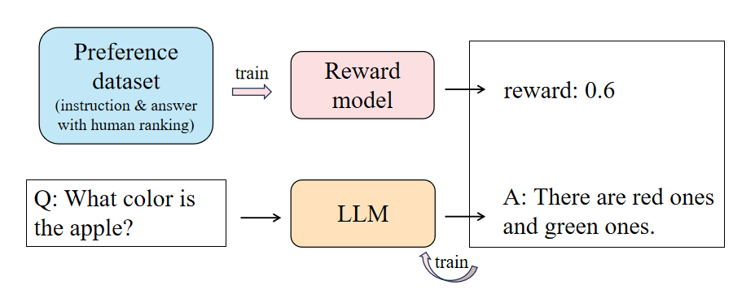
Preference alignment (optional)
Preference alignment is a next step used to align the LLM's answers with human expectations. It is more complex than SFT and often seen as optional. Common strategy is RLHF.
RLHF (Reinforcement Learning from Human Feedback) leverages a reward model and reinforcement learning to optimize the SFT model, ensuring that its output answers closely match those rated highly by humans.

Slide 10
Models in market
overview of popular LLM
Performance and Capability
Price for chat

Slide 11
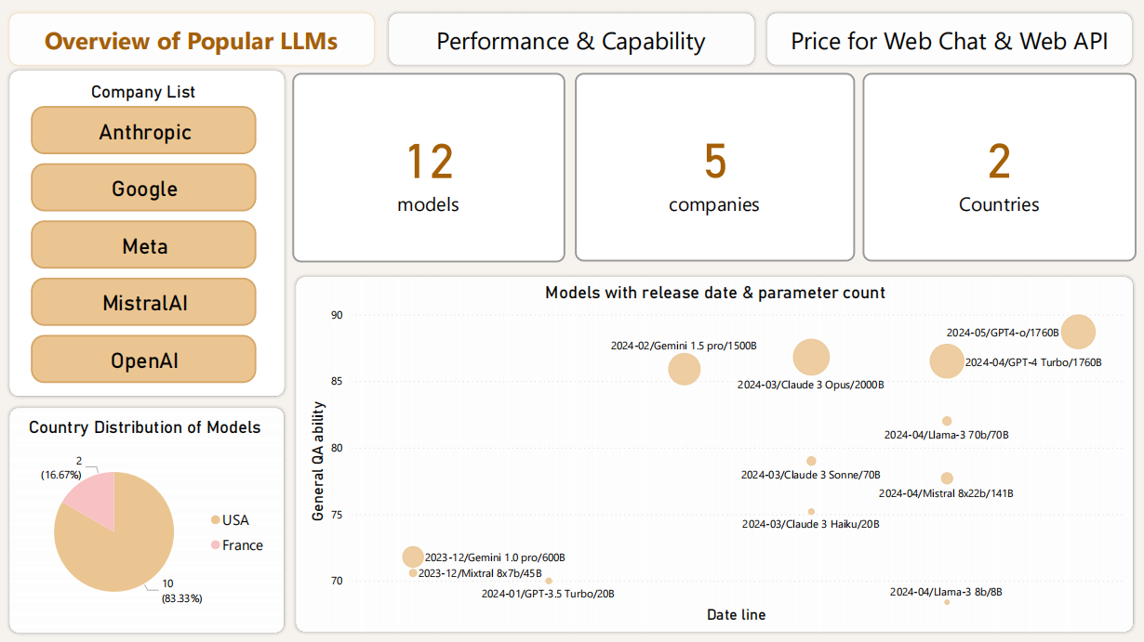
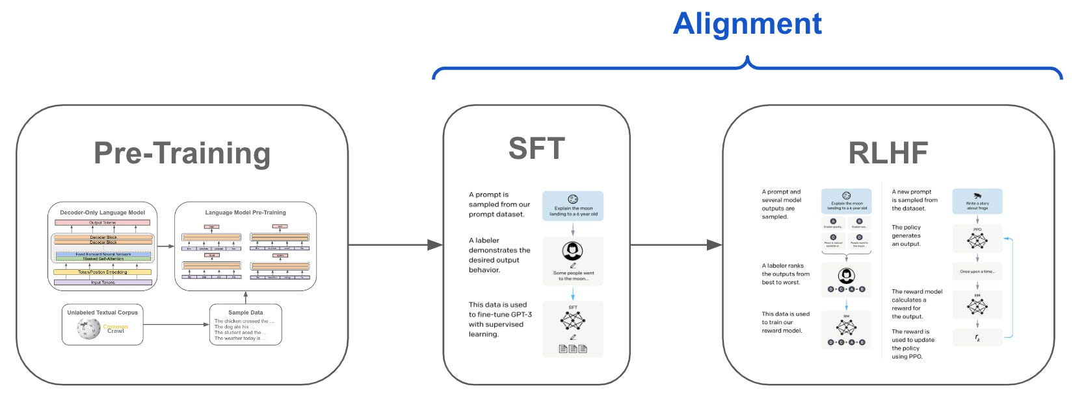

Slide 12
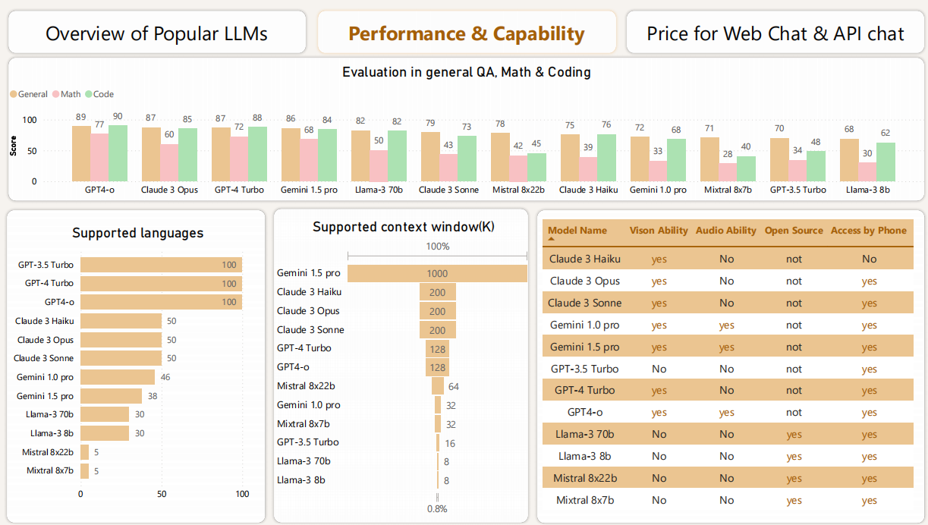

Slide 13
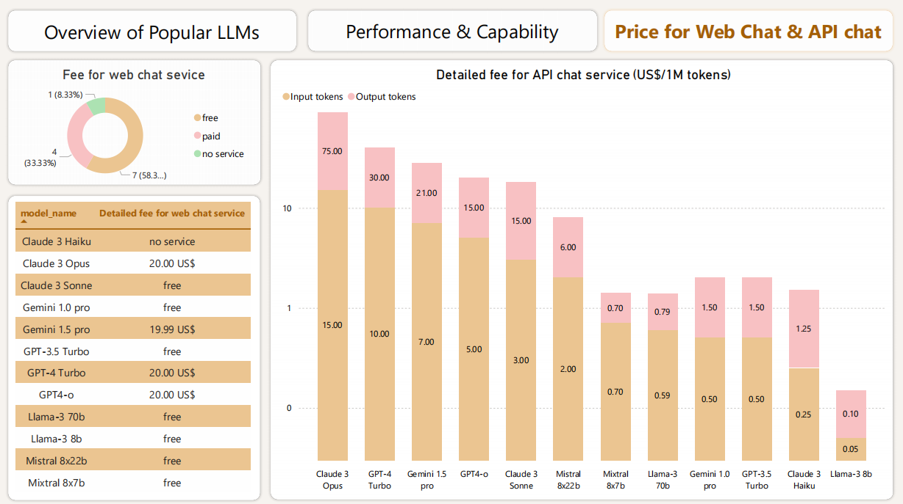

Slide 14
Paris is the city
Paris is the city of
Tokenizer
language model
Text generator
1652
5
42
171
of
0.337
that
0.133
Paris
is
the
city
in
0.133
with
0.083
where
0.036

Slide 15
Apple is round
round
LLM
Apple is ___
square
train

Slide 16
Instruction
Instruction Dataset
Labeled answer
Q: What color is the apple?
LLM
A: There are red ones and green ones.
Apple is round.
train

Slide 17
Preference dataset
(instruction & answer with human ranking)
train
Reward
model
reward: 0.6
Q: What color is the apple?
LLM
A: There are red ones and green ones.
train

Slide 18
instruct
instruct Dataset
labeled anwser
Q: What color is the apple?
Apple is round
A: There are red ones and green ones.
LLM
train model

Slide 19
instruct
labeled anwser
train model
There are red ones and green ones.
Preference datasets (contain several answers highly ranked by human for each question.)
Reward model
reward
Q: What color is the apple?
A: There are red ones and green ones.
LLM

Slide 20
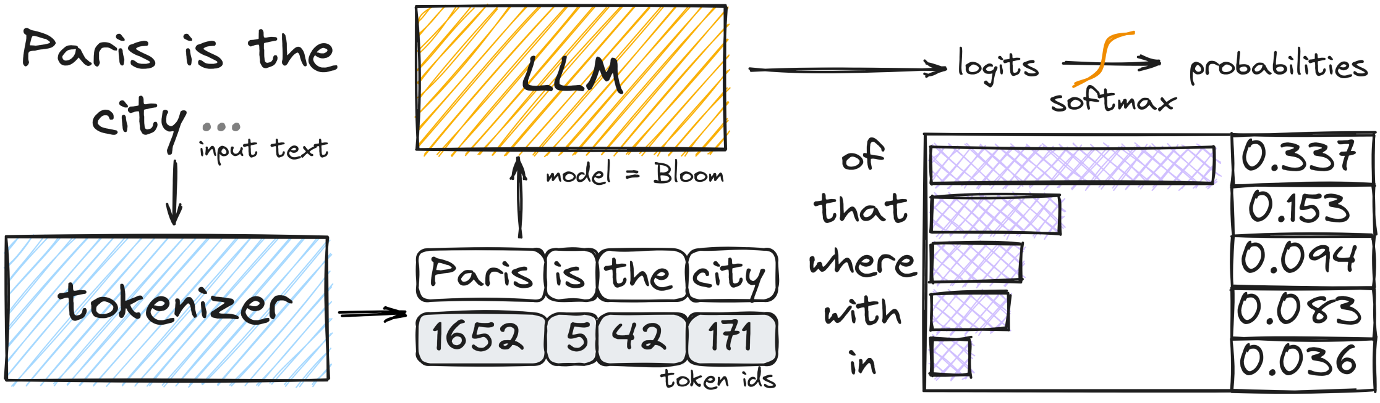
Paris is the city
Paris is the city of
Tokenizer
language model
Text generator
1652
5
42
171
of
0.337
that
0.133
Paris
is
the
city
in
0.133
with
0.083
where
0.036

Slide 21
language model
A language model is a deep learning model that is trained to predict the probability of a sequence of words in a language. Essentially, it learns the patterns and structures of a language from a given corpus of text data and can be used to predict or generate new text.
High-level view: the decoder-only Transformer architecture, which is used in every modern LLM. encoder-only, decoder-only, encoder-decoder
Tokenization: convert raw text data into a format that the model can understand, which involves splitting the text into tokens (usually words or subwords).
Attention mechanisms: including self-attention and scaled dot-product attention, which allows the model to focus on different parts of the input when producing an output.
Text generation: Learn about the different ways the model can generate output sequences. Common strategies include greedy decoding, beam search, top-k sampling, and nucleus sampling.
Preference datasets: These datasets typically contain several answers highly ranked by human for each question.

Slide 22
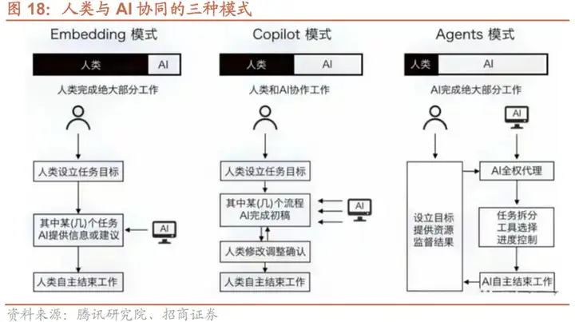
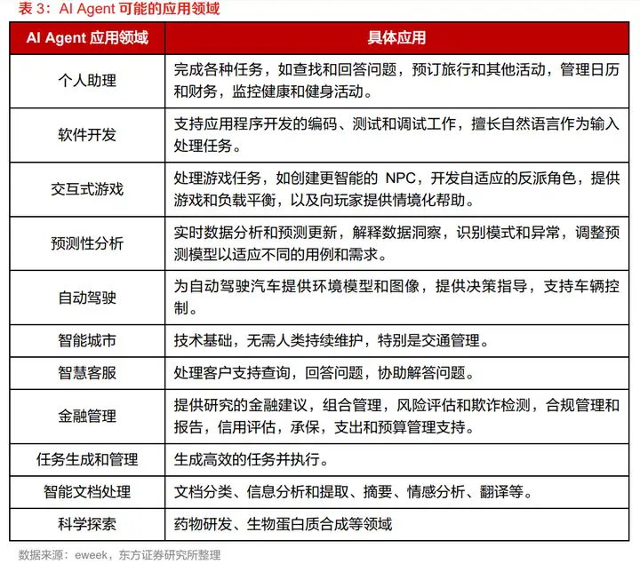
AI agent
如果说Copilot是“副驾驶”，那么Agent则可以算得上一个初级的“主驾驶”。AI Agent（人工智能代理）是一种能够感知环境、进行决策和执行动作的智能实体。不同于传统的人工智能，AI Agent具备通过独立思考、调用工具去逐步完成给定目标的能力。比如，告诉AI Agent帮忙下单一份外卖，它就可以直接调用APP选择外卖，再调用支付程序下单支付，无需人类去指定每一步的操作。
OpenAI的应用研究主管Lilian Weng撰写了一篇博客，认为AI Agent可能会成为新时代的开端。她提出了Agent=LLM+规划技能+记忆+工具使用的基础架构，其中LLM扮演了Agent的“大脑”，在这个系统中提供推理、规划等能力。
为大模型加上四肢，强化复杂任务处理能力

Slide 23
Large Languague Model
A large language model (LLM) typically refers to a language model that has been trained on a vast amount of text data and has a large number of parameters.
Mordern LLMs are capable of understanding prompts and instructions, generating human-like text, as well as performing a wide range of language-related tasks with high accuracy.
Attributes: large parameter count, architecture (decoder-only Transformer is popular), long process of pre-training.
, emergent
abilities of LLMs are formally defined as “the abilities that
are not present in small models but arise in large models”,
LLMs的涌现能力包括以下三种：in-context learning，instruction following，step-by-step reasoning。 ICL的能力是指语言模型在给定自然语言任务描述或者几个任务示例的条件下，在测试阶段就可以生成期望的输出，而不需要额外训练和梯度更新。 ICL能力的涌现也依赖于特定的下游任务。 指令遵循能力是指，使用自然语言描述格式化的多任务混合数据集微调，LLMs可以在没有见过的任务上，只要也是按照指令的形式描述，都可以做到很好。 逐步推理能力是指，使用思维链提示策略，LLMs可以解决复杂的推理问题，如数学应用题。 据推测，逐步推理能力是通过代码预训练获得的。
 | parameter count | architecture | pre-training
large language model | large | complex | long
normal language model | not large | not complex | shorter
LLM 的涌现能力被正式定义为 “在小型模型中不存在但在大型模型中产生的能力”，这是区别 LLM 与先前 PLM 的最显著特征之一。在这里，我们简 要介绍了 LLM 的三种典型涌现能力和具备这种能力的代表性模型。

Slide 24
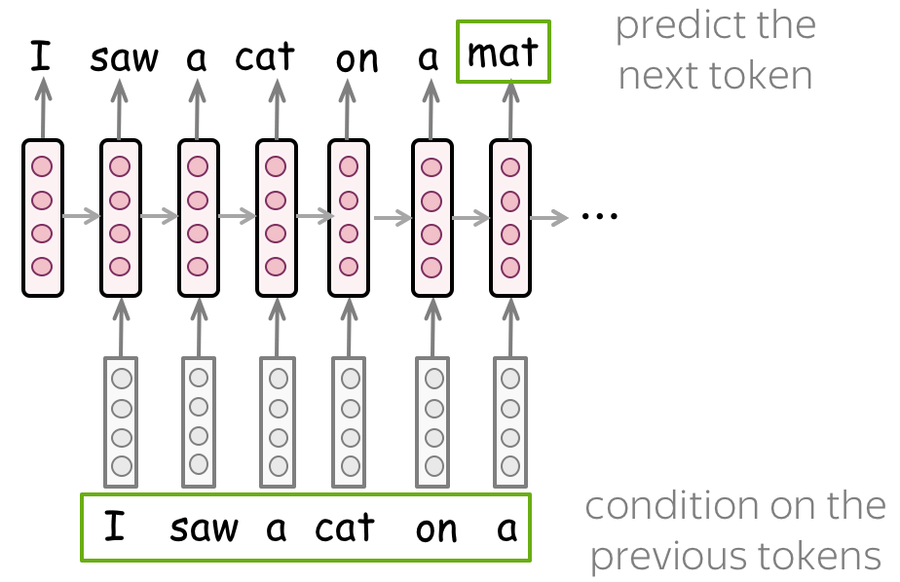
Preference alignment (optional)
Preference alignment is a next step used to align the LLM's answers with human expectations. It is more complex than SFT and often seen as optional. Common strategy is RLHF.
RLHF (Reinforcement Learning from Human Feedback) leverages a reward model that predicts the ranking by humans. This prediction is then used to optimize the SFT model through reinforcement learning, without drifting too far from the original model.

